Slide 1
As an Application Builder
Develop Windows Applications or
Web Applications Using ASP .Net
A Web service is designed for application builders, which provides application programming interface (API) or service interface.
A Web application is designed for end users, which provides human user interface, such as GUI.
Service broker
Registry
Registry
ASP .Net services: .asmx
WCF services: .svc WSDL/SOAP
Application builder
Service provider
Application /
Client
WCF services: RESTful
Service
What is the difference between a Web application and a Web service?
Java services

Slide 2
Applications Use Services Through Proxies
Client side
Service side
A proxy in client is a “virtual” object that creates a channel to a (remote) service. A client accesses the operations of the services by calling the “methods” of the proxy. The “virtual” means here: It does not contain the implementation (code) of the methods.
An endpoint in a service is an operation interface exposed to outside, so that a client can access the operation. It must include address, binding, name, and contract (opeation name, parameter types, return type)

Slide 3
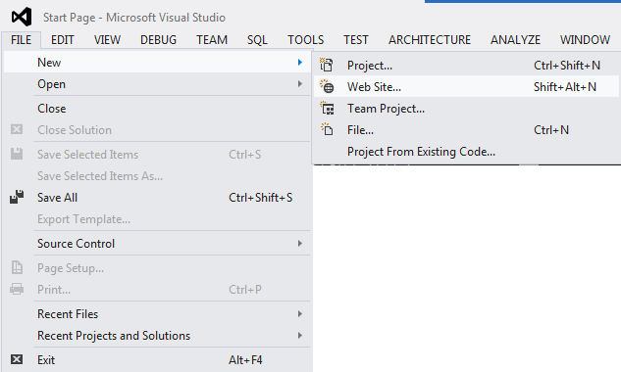
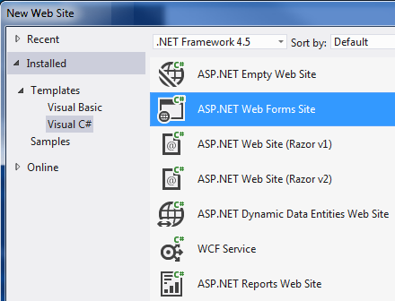
Develop a Web Application Using ASP .Net
What is the difference between a Web Forms Site and a Web Service?
What is the difference between an ASP .Net Web Service and a WCF Web Service?
.asmx and .svc

Slide 4
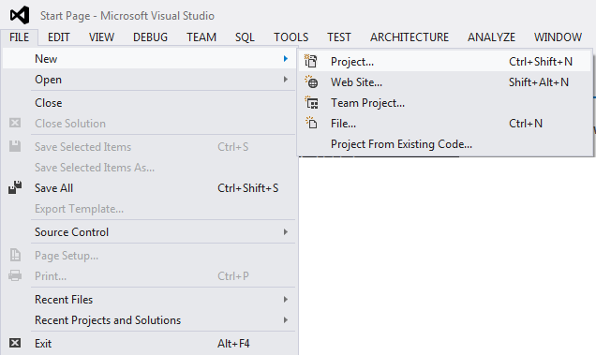
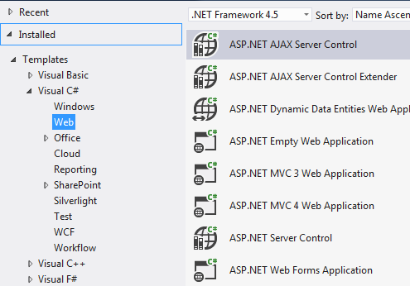
Develop a Web Application Using ASP .Net
Use this option in assignment
Note: In VS, you can also choose to use: New – Project – ASP .Net Web Forms Application. This application will use a “Project File” to link all the components together. Allow static port number, while New – Web Site option will create those files only that are needed in the website.

Slide 5
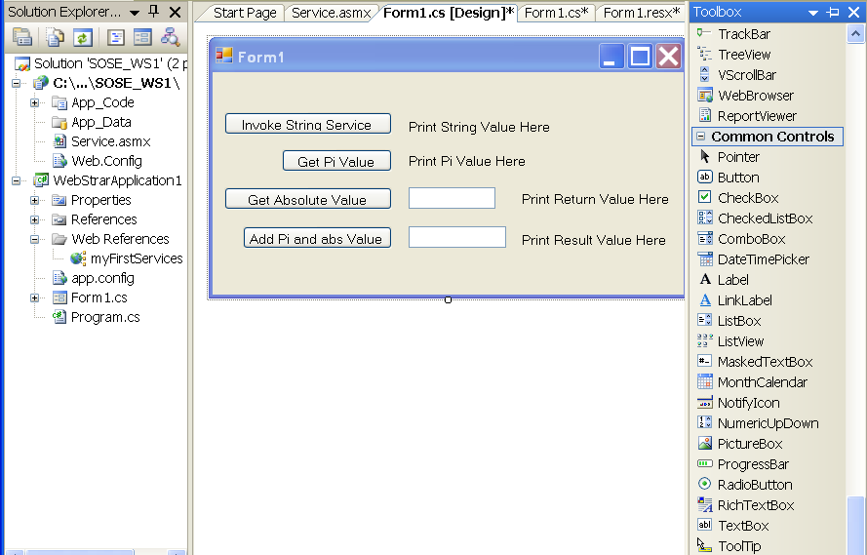
GUI Design for Application Building
Double click each button to generate the code template and the code page.
Assignment 3: “TryIt” page for your service.

Slide 6
Code Behind GUI: Template and User Code
private void Button1_Click(object sender, System.EventArgs e) {
service hw = new service();
this.label1.Text = hw.HelloWorld();
}
private void Button2_Click(object sender, System.EventArgs e) {
service pivar = new service();
this.label2.Text = pivar.PiValue().ToString();
}
private void Button3_Click(object sender, System.EventArgs e) {
service absvar = new service();
int number = Convert.ToInt32(this.textBox1.Text);
int result = absvar.abs(number);
this.label3.Text = result.ToString();
}
private void Button4_Click(object sender, System.EventArgs e) {
int number = Convert.ToInt32(this.textBox2.Text);
service absvar = new service();
number = absvar.abs(number);
double result = number + absvar.PiValue();
this.label4.Text = result.ToString();
}
Template code must be generated by system: double click the button in the GUI Design page
Template code must be generated by system: double click the button in the GUI Design page
Template code must be generated by system: double click the button in the GUI Design page
You enter the user code part only. If you enter the template code, the code is registered to the event of the button
You enter the user code part only. If you enter the template code, the code is registered to the event of the button

Slide 7
Proxy Object: What does it represent?
// Service Provider
// Service requester / client
public class Service : IService
{
public string HelloWorld()
{
return "Hello World";
}
public double PiValue()
{
double pi = System.Math.PI;
return (pi);
}
public int absValue(int x)
{
if (x >= 0) return (x);
else return (-x);
}
}
service absvar = new service();
channels
Proxy object
{
…
public string HelloWorld();
public double PiValue();
public int absValue(int x);
}
Method name
Parameter list
Return type
A real object created from a class would have the code of the methods

Slide 8
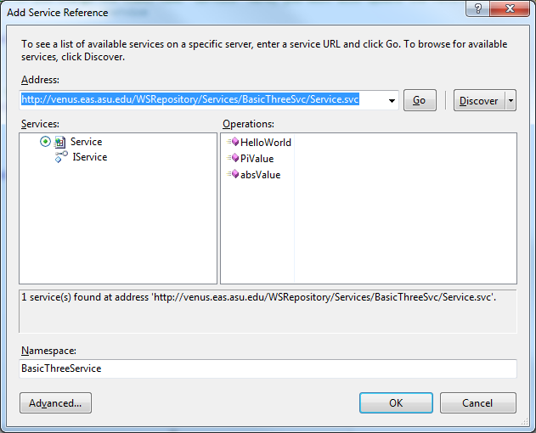
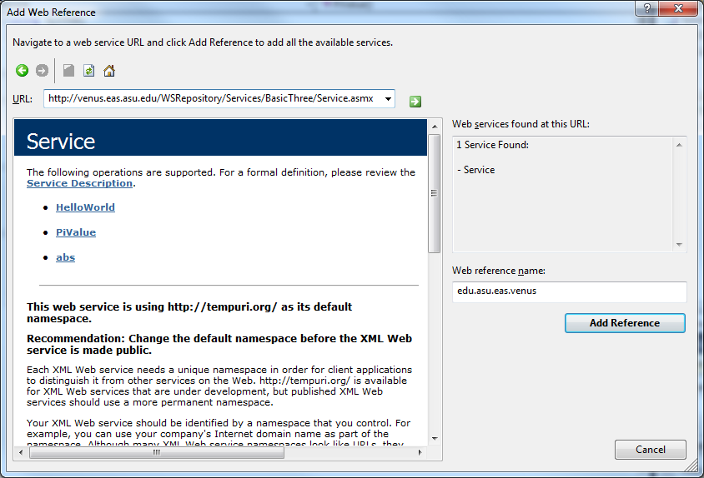
Creating the Proxy (Statically)
Use “Add Service Reference” to add .svc service, e.g., http://venus.eas.asu.edu/WSRepository/Services/BasicThreeSvc/Service.svc
Use “Add Web Reference” to add .asmx service, e.g., http://venus.eas.asu.edu/WSRepository/Services/BasicThree/Service.asmx

Slide 9
Add Web Reference vs. Add Service Reference
Services developed in ASP .Net (.Net 2.0) has an extension .asmx
Services developed in WCF: Windows Communication Foundation (.Net 3.0 or later) has an extension .svc
Add Web Reference is used for creating the proxy to .asmx services
Add Service Reference is used for creating the proxy to .svc services.
As there are many .asmx services are available, both binding methods are supported.

Slide 10
Static Binding vs. Dynamic Binding
In object-oriented programming, dynamic binding allows a method call to be bound to the initial address of a method at run time, instead of at compilation time.
The method must be a virtual method, to allow the child class to redefine the method.
In service-oriented programming, dynamic binding, also called dynamic proxy, allows a service to be bound to an application at run time, instead of at compilation time.
Do we need dynamic proxy?
Can we choose service and bind service at run time?

Slide 11
Dynamic Business Logic is a Necessity
Travel Agent
User enters date of travel
User enters departing city
User enters destination
Validate data
Book flight
Book hotel
Book rental car
WSDL Web service list in an editable text file
http://www.usarlines.webservice?wsdl
http://www.swarlines.webservice?wsdl
http://www.unitedarlines.webservice?wsdl
http://www.usdeltaarlines.webservice?wsdl
http://www.lufthansaarlines.webservice?wsdl
…
http://www.hilton.webservice?wsdl
http://www.doubletree.webservice?wsdl
http://www.daysin.webservice?wsdl
http://www.fourseason.webservice?wsdl
http://www.hyatt.webservice?wsdl
…
http://www.avis.webservice?wsdl
http://www.hertz.webservice?wsdl
http://www.enterprise.webservice?wsdl
http://www.thrifty.webservice?wsdl
…
Build proxy and call
http://www.airfrance.webservice?wsdl
Build proxy and call
Build proxy and call
http://www.holidayinn.webservice?wsdl
How does a client bind to a RESTful service?
Always statically
Always dynamically
Both statically and dynamically
Neither statically nor dynamically
http://www.budget.webservice?wsdl

Slide 12
Dynamic Proxy and Service Invocation
For the permanent WSDL services needed, we can use the static binding “Add Service Reference” or “Add Web Reference” to create static proxy;
We can dynamically discover new services:
Search for WSDL files;
Analyze a WSDL file to find the remotable operations and input and output types
Use dynamic proxy to call services that are not bound during the compilation time;
Dynamically binding and calling services have many applications:
Dynamic business: Placing the URLs of Web services in a textfile, call the WS from the list, and editing the list any time;
Web service Testing

Slide 13
Web Service Testing
Software testing often takes more effort than software development, and thus there are huge demands on software testing professionals;
Software black-box testing vs. white-box testing
How do we do WSDL Web service testing?
Source code not available: Black-box Testing;
WSDL file is available: WSDL analysis to obtain URL, operations, input and output types;
Generate test cases based on the input types;
Dynamically invoke the Web service;
Analyze the return values
Why dynamic?

Slide 14
Creating a Web-Service-Testing Service
Defining the Interface
using System;
namespace WebserviceTesting
{
[ServiceContract]
public interface IService1
{
[OperationContract]
string WsTesting(string wsUrl, string operationName, string[] args);
}
}
WSDL URL
Input parameters
Test one operation. Need to use a loop to call all the operations in order test all operations in a web service completely.

Slide 15
Creating a Web-Service-Testing Service
using System;
using System.ServiceModel;
using System.ServiceModel.Web;
using WcfSamples.DynamicProxy;
using System.ServiceModel.Description;
namespace WebserviceTesting {
public class Service1 : IService1 {
public String WsTesting(string webUrl, String[] args) {
String outMessage ="";
DynamicProxyFactory factory = new DynamicProxyFactory(webUrl);
foreach (ServiceEndpoint endpoint in factory.Endpoints) {
DynamicProxy proxy = factory.CreateProxy(endpoint);
outMessage = proxy.CallMethod(operationName, args).ToString();
}
return outMessage;
}
}
}
Creating Dynamic Proxy
How do I know the end points in a Web service?

Slide 16
Exploring WSDL File: Using Reflection
http://msdn.microsoft.com/en-us/library/ms173183(v=vs.100).aspx
Reflection provides objects (of type Type) that encapsulate assemblies, modules and types.
You can use reflection to dynamically create an instance of a type, bind the type to an existing object, or get the type from an existing object, and invoke its methods or access its fields and properties;
Use Reflection.MethodInfo class to discover the attributes of a method and provides access to method metadata. For example
List<object> test = new List<object>();
for (int i = 0; i < parameters.Length; i++) {
test.Add(insertTestType(parameters[i], param[i].ToString()));
}
MethodInfo mInfo = wsdlClass.GetType().GetMethod(op[opName]);
object result = mInfo.Invoke(wsdlClass, test.ToArray());

Slide 17
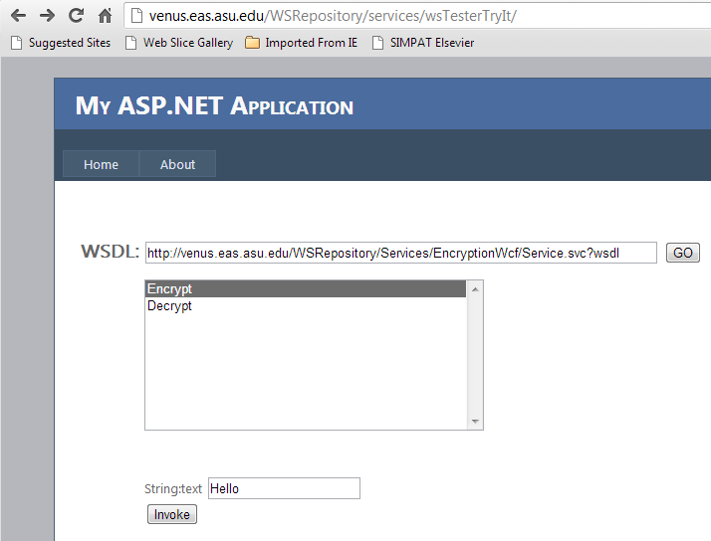
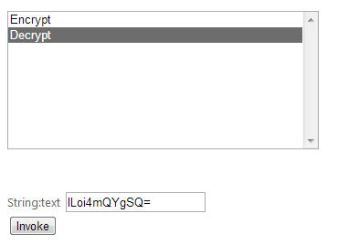
WS Testing Tool in ASU Repository: http://venus.eas.asu.edu/WSRepository/repository.html
lLoi4mQYgSQ=
Hello

Slide 18
Perform Dynamic Test for RESTful Services?
RESTful services are dynamic and can be test by constructing the complete URL:
Base URL + OperationName + Parameters
The problem is that there is no WSDL file or standard template on “OperationName and Parameters” that a computer program can read and extract to perform:
Base URL + OperationName + Parameters
Manually provide the information on OperationName + Parameters.
Automatic testing is difficult

Slide 19
Web Application State Management
HTTP is stateless:
Every request is independent of other requests.
Every package is independent of other packages.
Web applications are stateless by default: Every access to an application, it is considered from a new client;
However, we do need stateful computing in many cases. For example, add to the cart service, counter, timer, etc. We cannot use class variable for storing data to be accessed in the next request.
Special considerations and mechanisms are necessary in order to provide stateful Web applications.

Slide 20
Different Methods of State Management
View State: A variable that can hold information for multiple access within a page.
Cross-Page Posting: Transfer information cross the pages.
Text File: Store text into server file and retrieve it later
Session State: Allow a user to store information in the memory on the server for the same session.
Application State: Allow a user to store data in memory on the server for all sessions.
XML file: store data to server disk
Cookies: Store information on client’s hard drive, so that the client can return to a previous state after close and reopen the browser.
Database, Caching, and Ontology: in CSE446/598 (Text Part II)
Chapter 3
Chapter 5

Slide 21
ViewState
When a user accesses an ASPX page, ASP .Net generates an xhtml (html) page for users to review the information;
If Silverlight and WPF are used, XMAIL is used;
A hidden field is generated in the html/xhtml page;
It provides a collection (array) of strings;
ASPX page can read and write this field in the syntax of ViewState[“name”];

Slide 22
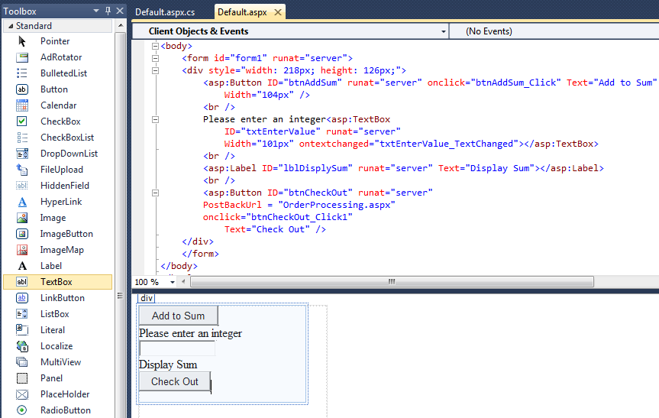
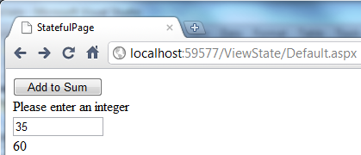
Example: An Web Accumulator
GUI Source View
GUI Design View

Slide 23
The Code behind the ASPX Page
using System; using System.Web; using System.Web.UI.WebControls;
using System.Web.UI.WebControls.WebParts;
public partial class _Default : System.Web.UI.Page {
Int32 FinalAmt = 0; // not useful for storing value for next access
protected void btnAddSum_Click(object sender, EventArgs e) {
Int32 sum = 0;
if (ViewState["Sum"] == null) ViewState["Sum"] = 0;
else {
Int32 newValue = Convert.ToInt32(this.txtEnterValue.Text);
sum = (Int32)ViewState["Sum"] + newValue;
ViewState["Sum"] = sum;
this.lblDisplySum.Text = sum.ToString();
FinalAmt = sum; // not useful for storing value for next access
}
}
}

Slide 24
Transfer Data Cross Pages
ViewState[“name”] data can be accessed multiple times, but from the current page only;
Cross-Page Posting is a method of posting data from one page back to the server, and then to another page;
It uses PostBackUrl = “Destination.aspx” attribute to link the current page to the destination page;
In the destination page, access the public method in the source page.
WebPage1.aspx
ViewState[“name”]
Web Server
Cross-Page Posting
WebPage2.aspx

Slide 25
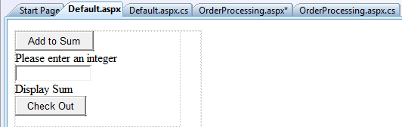
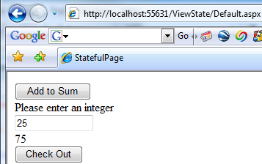
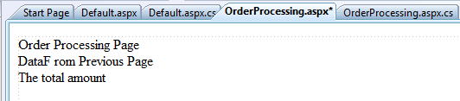
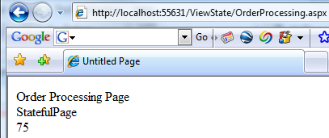
Transfer data from Default.aspx to OrderProcessing.aspx
25

Slide 26
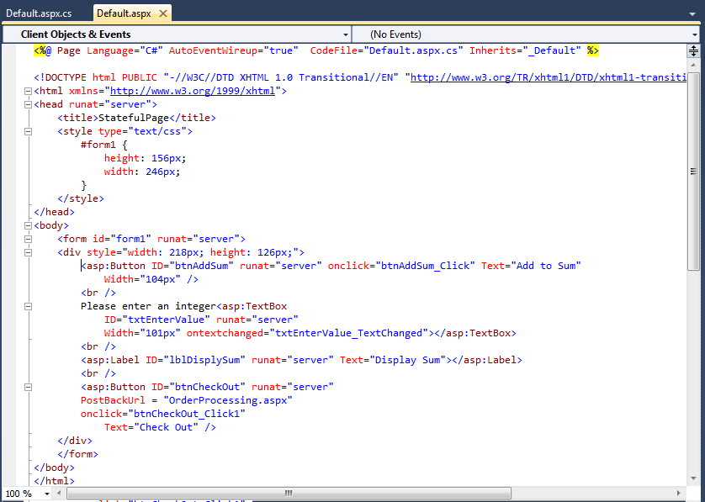
HTML Source of Default.aspx

Slide 27
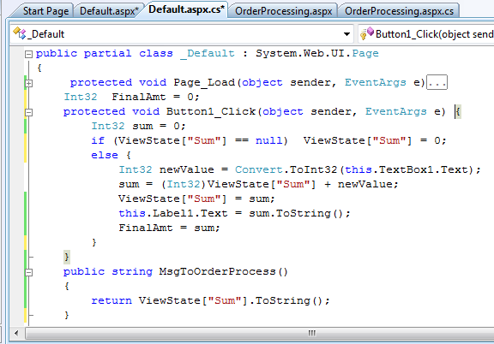
C# Code Behind the Default.aspx
To be called from OrderProcessing.aspx page, similar to callback event handler in chapter 2.
Note: You cannot use FinalAmt here, because the value no longer exist after leaving this page.

Slide 28
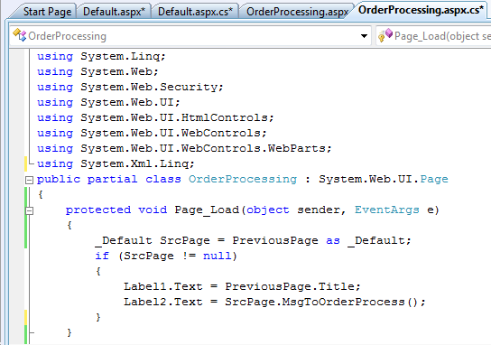
C# Code Behind OrderProcessing.aspx
Method in Default page

Slide 29
Viewstate Postback on Web Farm
When a web server running IIS uses ViewState to store information, the ViewState data is encrypted automatically before it is stored;
When postback, only the same host can decrypt the data;
If the application is hosted by a Web Farm or virtual servers, like ASU WebStrar and V-Lab, make sure that <machineKey> in machine.config specifies the same validationKey and validation algorithm. machine.config is located at
C:\Windows\Microsoft.NET\Framework\[version]\config\machine.config
AutoGenerate cannot be used in Web Farm or cluster

Slide 30
Use Text File for Your Services
View State: A variable that can hold information for multiple access within a page.
Cross-Page Posting: Transfer information cross the pages.
Text File: Store text into server file and retrieve it later
Session State: Allow a user to store information in the memory on the server for the same session.
Application State: Allow a user to store data in memory on the server for all sessions.
XML file: store data to server disk
Cookies: Store information on client’s hard drive, so that the client can return to a previous state after close and reopen the browser.
Database, Caching, and Ontology: in CSE446/598 (Text Part II)
Chapter 3
Chapter 5

Slide 31
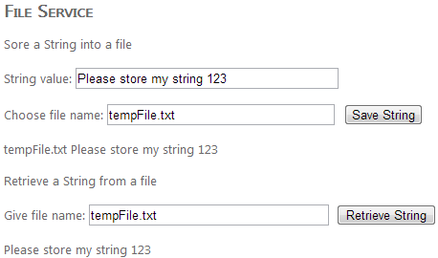
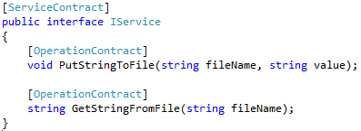
Server File System and Service
http://venus.eas.asu.edu/wsrepository/Services/FileServiceTryIt/
TryIt Page
http://venus.eas.asu.edu/wsrepository/Services/FileService/service.svc
Service Interface

Slide 32
FileService Code: PutStringToFile
using System;
using System.Web;
using System.IO;
using System.Xml;
public class Service : IService {
public void PutStringToFile(string fileName, string value) {
string fLocation = Path.Combine(HttpRuntime.AppDomainAppPath, @"App_Data"); // Get path from server root to current
fLocation = Path.Combine(fLocation, fileName); // From current to App_Data
if (File.Exists(fLocation)) {
File.Delete(fLocation);
}
using (StreamWriter sw = File.CreateText(fLocation)) {
sw.WriteLine(value);
}
}
// Continue to next page
How do you find the current location

Slide 33
FileService Code: GetStringFromFile
// Continued from previous page
public string GetStringFromFile(string fileName) {
string fLocation = Path.Combine(HttpRuntime.AppDomainAppPath, @"App_Data"); // From server root to current
fLocation = Path.Combine(fLocation, fileName); // From current to App_Data
if (!File.Exists(fLocation)) {
return "File not exist";
}
using (StreamReader sr = File.OpenText(fLocation)) {
string s = sr.ReadLine();
return s;
}
}
}

Slide 34
Case Study: Develop an Online Shopping System
Application (workflow)
Services
Services
Overview of the system
Code download: http://venus.eas.asu.edu/WSrepository/teaching/cse445598/EnterpriseOrderProcessingCode.zip

Slide 35
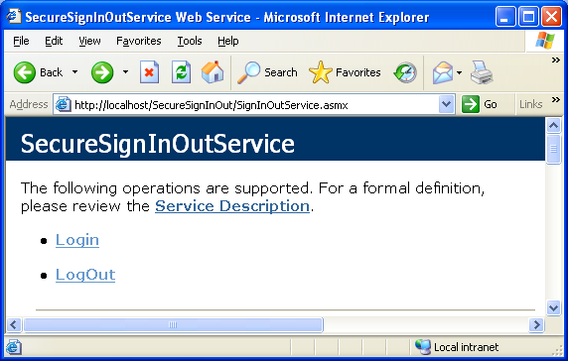
Login / logout Service

Slide 36
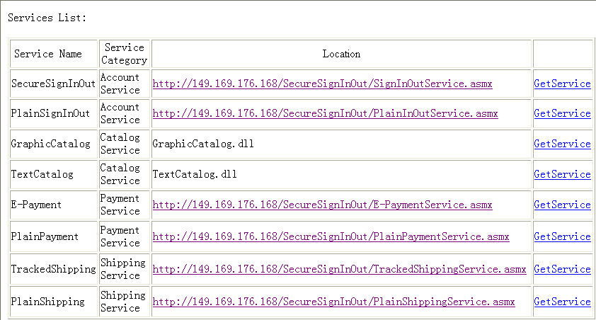
Ad Hoc Service Directory

Slide 37
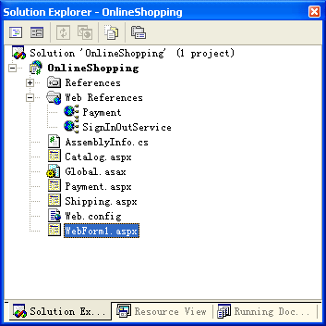
ASP.Net Project Stack
3
2
1

Slide 38
namespace OnlineShopping {
public class WebForm1 : System.Web.UI.Page {
protected System.Web.UI.WebControls.TextBox textBox1;
protected System.Web.UI.WebControls.TextBox textBox2;
protected System.Web.UI.WebControls.Label label1;
protected System.Web.UI.WebControls.Label label2;
protected System.Web.UI.WebControls.Button Button1;
private void Page_Load(object sender, System.EventArgs e) {
// Put user code to initialize the page here
}
#region Web Form Designer generated code
override protected void OnInit(EventArgs e) {
// CODEGEN: This call is required by the ASP.NET Web Form Designer.
InitializeComponent();
base.OnInit(e);
}
/// <summary>
/// Required method for Designer support - do not modify
/// the contents of this method with the code editor.
/// </summary>
private void InitializeComponent() {
this.Button1.Click += new System.EventHandler(this.Button1_Click);
this.Load += new System.EventHandler(this.Page_Load);
} #endregion
private void Button1_Click(object sender, System.EventArgs e)
{
SecureSignInOutService Login = new SecureSignInOutService();
if( Login.Login(textBox1.Text, textBox2.Text) )
Response.Redirect("Payment.aspx");
else
label2.Text = “Login failed!";
}
}
}
The code for the
WebForm1.aspx
using System;
using System.Collections;
using System.ComponentModel;
using System.Data;
using System.Drawing;
using System.Web;
using System.Web.SessionState;
using System.Web.UI;
using System.Web.UI.WebControls;
using System.Web.UI.HtmlControls;
using OnlineShopping.SignInOutService;

Slide 39
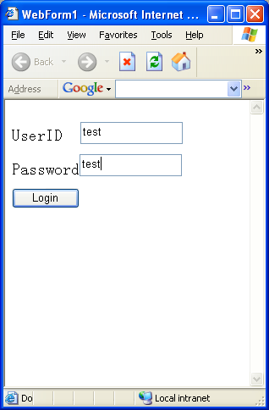
When the code runs, …
private void Button1_Click(object sender, System.EventArgs e)
{
SecureSignInOutService Login = new SecureSignInOutService();
if (Login.Login(textBox1.Text, textBox2.Text) )
Response.Redirect("Payment.aspx");
else
label2.Text = “Login failed!";
}
Transit from current page to another. It does not carry a value.

Slide 40
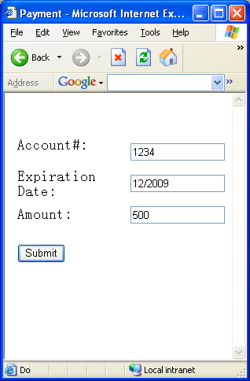
After login succeeds, credit card charge
Web service offered by the bank:
[WebMethod]
public System.Boolean VerifyPayment(System.Single CardNumber, System.String PWD, System.String Adress)
{
if ( CardNumber == 1234 && PWD == "12/2009" )
return true;
else
return false;
}

Slide 41
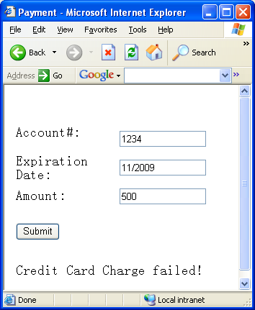
Application Code Responds to Credit Card Charge
private void Button1_Click(object sender, System.EventArgs e)
{
EPaymentService payment = new EPaymentService();
if (payment.VerifyPayment(Convert.ToInt32(textBox1.Text), textBox2.Text, textBox3.Text))
Response.Redirect("Shipping.aspx");
else
Label4.Text = "Credit Card Charge failed!";
}

Slide 42
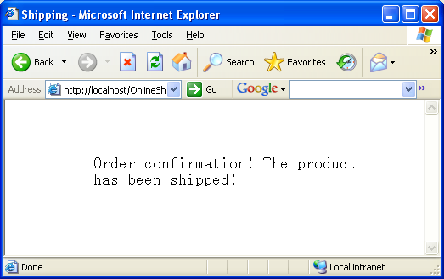
After credit card charge, shipping is called

